Slide 1
Team ReLU CMPUT 399
Final Project
By: Taylor Bos Kevin Gordon Jun Ma Siqi Yan
Notes:
Say hello, introduce yourselves, big smiles XD

Slide 2
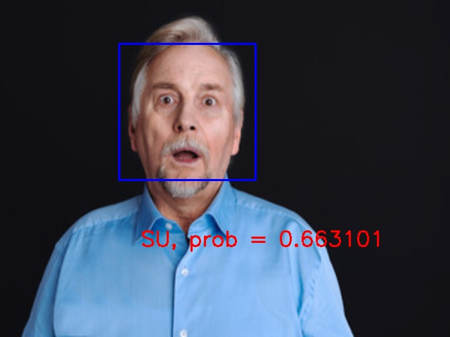
Classify Emotion
in Real Time
Using a Convolutional Neural Network

Slide 3
A Brief History

Slide 4
A Brief History of Facial Emotion
Psychology research
Human emotion is quantifiable
6 universal facial emotion expressions
Happiness
Anger
Sadness
Disgust
Surprise
Fear
Notes:
Psych-> idea that emotion is discrete and measurable -> Ekman (spinoff Lie to Me) -> “Constants Across Cultures in the Face and Emotion” there are six universally recognizable emotions displayed through facial expressions:
Even Disney plays on this idea: Inside Out (2015)

Slide 5
A Brief History of Facial Emotion
Computer Science Research
"Affective Computing" (Picard 1995)
Connect psychology and computer science
Recognize and stimulate human emotion
Notes:
R.W. Picard coined the term with the 1995 book "Affective Computing" -> tried to connect the fields, with the goal of developing systems to recognize human emotion, stimulate human emotion and adapt in constant feedback.

Slide 6
A Brief History of Facial Emotion
Computer Science Research
Early 90's - explored using RNN's
Late 90's - CNNs shown to be superior
Recent research (2016) encourages further study
Notes:
beginning of this field of study several approaches were explored such as using a rnn in 1993 by Kobayashi and Hara[10].
CNNs were shown to outperform the accuracy of other models as shown in C. Nebauer’s paper “Evaluation of Convolutional Neural Networks for Visual Recognition” in 1998 [11]. Since then convolutional neural networks have been primarily used for the problem of facial emotion recognition.
“Multimodal Deep Convolutional Neural Network for Audio-Visual Emotion Recognition” (2016) combined facial expression and speech pattern recognition[9] [Good results].
We were inspired by the study done by Dan Duncan, Gautam Shine, and Chris English Stanford CS231 2016in which they used a pretrained convolutional neural network to classify facial emotions in real time [1].

Slide 7
The Stanford Project
“Facial Emotion Recognition in Real TIme” by Duncan, Shine, and English
Test accuracy: 57.1%
Frame rate: 2.5 frames per second

Slide 8
The Network

Slide 9
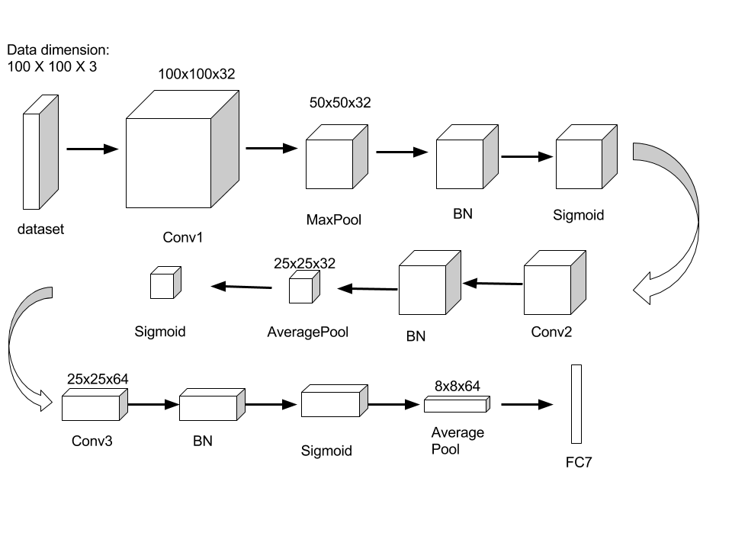
The 3-layer Convolutional Net
Batch Normalization
SGD+Momentum
Software: Caffe
Hardware: Nvidia GTX 950 GPU 2GB

Slide 10
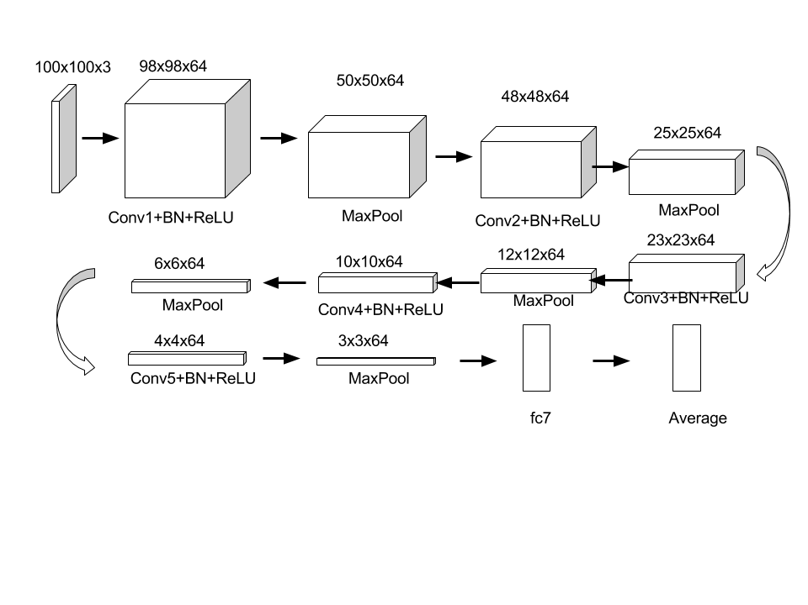
The Network
Architecture
5 Layer CNN
64 filters / conv layer
3x3 filters

Slide 11
The Network
Architecture
5 Layer CNN
64 filters / conv layer
3x3 filters
Batch normalization
Max pooling
ReLU

Slide 12
The Network
Architecture
5 Layer CNN
64 filters / conv layer
3x3 filters
Batch normalization
Max pooling
ReLU
Fully connected layer 6
Softmax loss

Slide 13
The Network
Training
Random weight initialization
Batch size 64
Momentum update
Trained for 2000 batches

Slide 14
The Dataset

Slide 15
The Dataset
KDEF
Validated facial emotion psychology inventory
Created for psychology/medical research
Standardized

Slide 16
The Dataset
KDEF
Validated facial emotion psychology inventory
Created for psychology/medical research
Standardized
7 emotions
70 individuals (35 M/35 FM)
5 angles

Slide 17
The Dataset
KDEF
Validated facial emotion psychology inventory
Created for psychology/medical research
Standardized
7 emotions
70 individuals (35 M/35 FM)
5 angles
4900 images!

Slide 18
The Dataset
Customized KDEF
Design constraints
Use only front angle
~1000 images
Split into training/test
Augment
Each image -> 7 images
Apply noise, jitter, crops, mirroring, colour, contrast, rotations

Slide 19
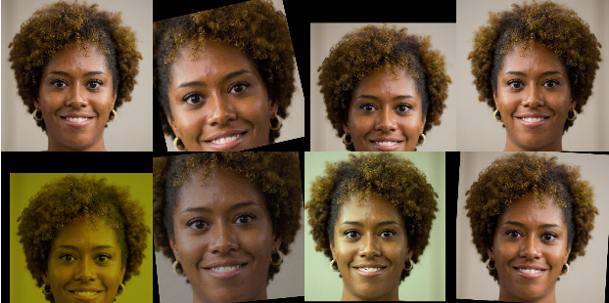
The Dataset
Customized KDEF + JAFFE Database
+ 213 original images
Augment
Each image -> 7 images
Apply noise, jitter, crops, mirroring,
colour, contrast, rotations
Notes:
The Japanese Female Facial Expression (JAFFE) Database
The database contains 213 images of 7 facial expressions (6 basic facial expressions + 1 neutral) posed by 10 Japanese female models. Each image has been rated on 6 emotion adjectives by 60 Japanese subjects. The database was planned and assembled by Michael Lyons, Miyuki Kamachi, and Jiro Gyoba. We thank Reiko Kubota for her help as a research assistant. The photos were taken at the Psychology Department in Kyushu University.

Slide 20
Experiments

Slide 21
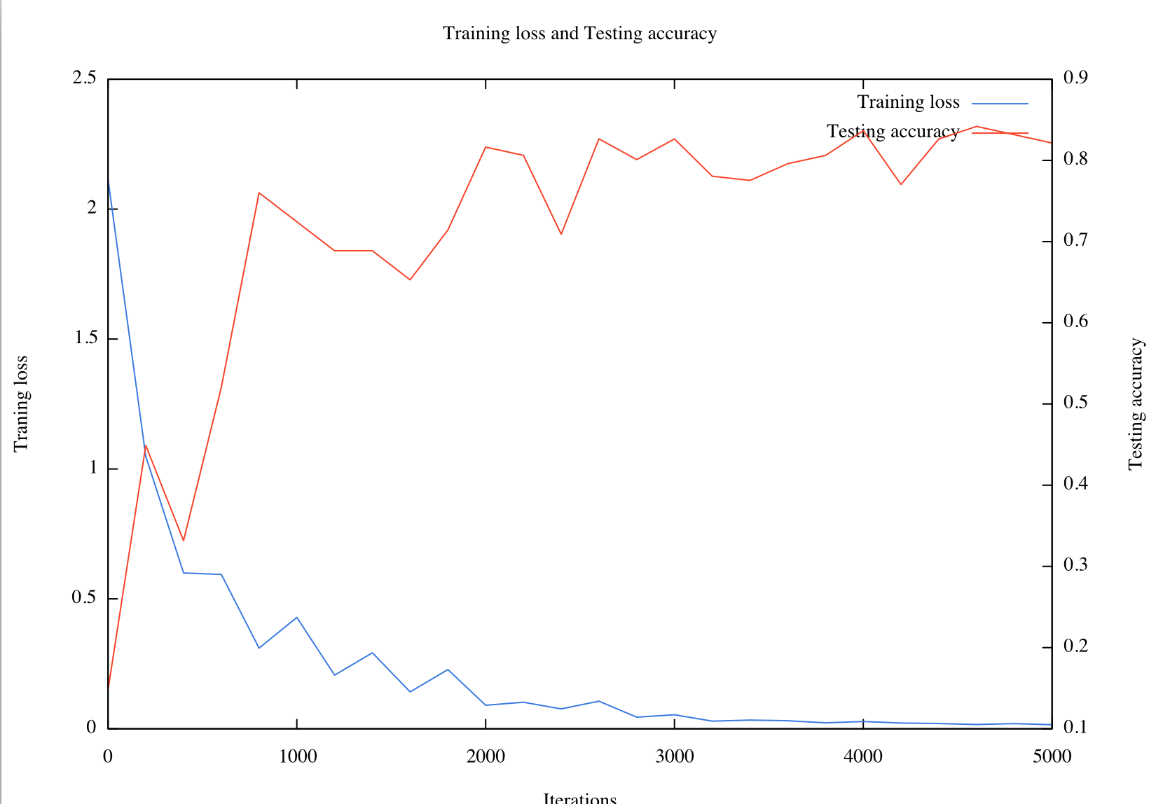
Training on the Original KDEF Dataset
Selected 981 images
Batch size: 100
Learning rate: 1e-3
Momentum: 0.9
Total iter: 5000
~83% on test set
Not working very well in reality

Slide 22
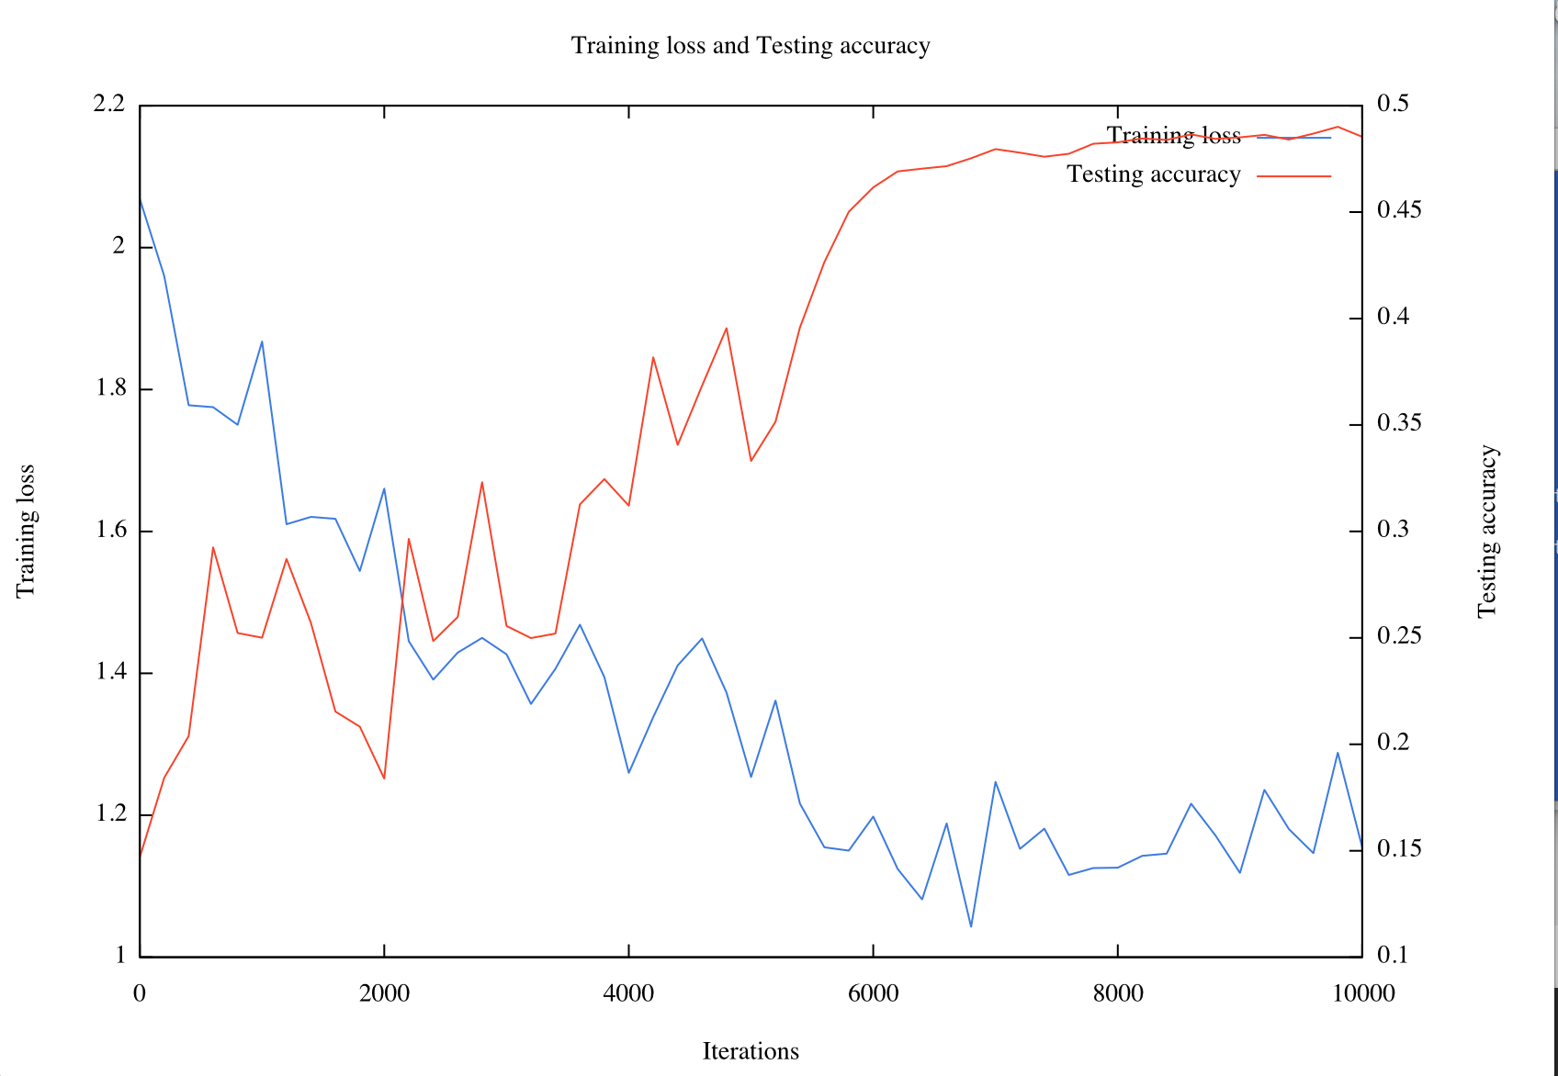
Augmented KDEF Dataset
7840 images
Batch size: 100
Learning rate: 1e-3 ~ 1e-5
Momentum: 0.9
Total iter: 10000
~49% on test set

Slide 23
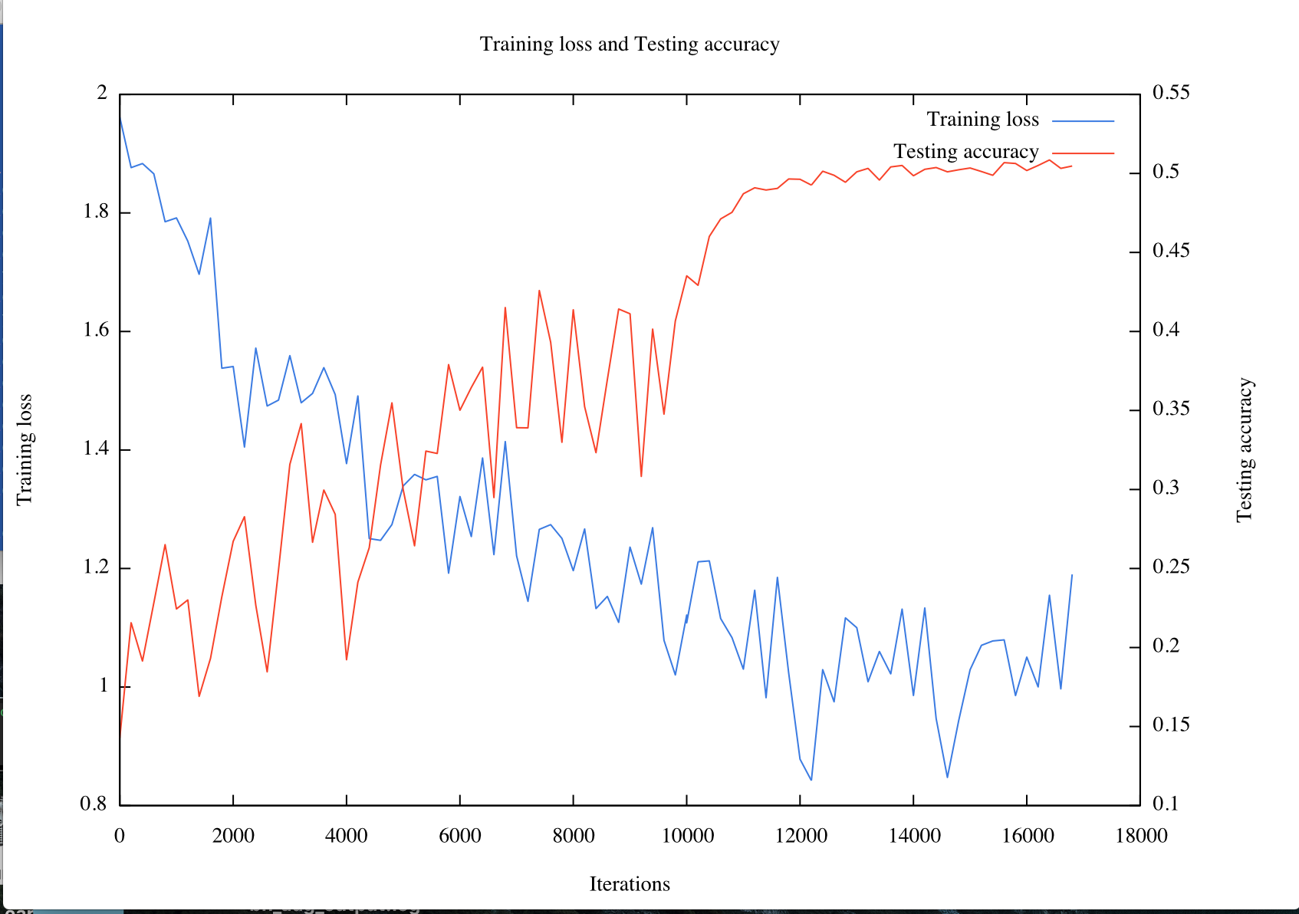
Mixture of KDEF and JAFFE
9542 images
Batch size: 100
Learning rate: 1e-3 ~ 1e-5
Momentum: 0.9
Total iter: 16800
~50% on test set
Performance is acceptable in reality

Slide 24
Real Time Classification

Slide 25
Real Time Classification
Classification engine:
Haar-Cascade Classifier to detect face and generate bounding box

Slide 26
Real Time Classification
Classification engine:
Haar-Cascade Classifier to detect face and generate bounding box
Histogram Equalization (reduce the effect of light)
Gaussian Filter (slightly increase the accuracy)

Slide 27
Real Time Classification
Classification engine:
Haar-Cascade Classifier to detect face and generate bounding box
Histogram Equalization (reduce the effect of light)
Gaussian Filter (slightly increase the accuracy)
Frames per second:
5 ~ 7 fps on laptop
13 ~ 15 fps on desktop

Slide 28
Real Time Classification
Classification engine:
Haar-Cascade Classifier to detect face and generate bounding box
Histogram Equalization (reduce the effect of light)
Gaussian Filter (slightly increase the accuracy)
Frames per second:
5 ~ 7 fps on laptop
13 ~ 15 fps on desktop
Happy (HA), Sad (SA) and Surprised (SU) are more recognizable
Neutral (NE), Angry (AN) and Disgusted (DI) are harder to be recognized
Fear (FE) is never detected in our tests

Slide 29
Demo

Slide 30
Questions?

Slide 31
Thank you!
Notes:
Intentionally blank

